Slide 1
Red Hat OpenStack Platform 10 (Newton) Installation and Configuration

Slide 2
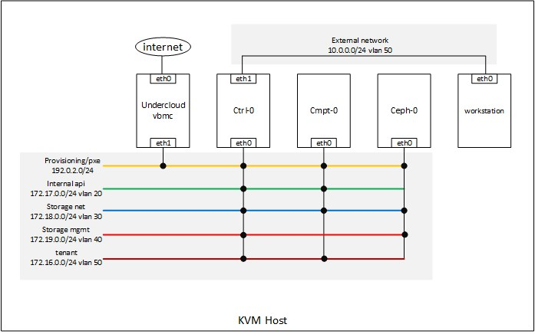
Topology

Slide 3
VM Specification
Undercloud - 8 vcpu - 16 Gb ram - 80 Gb disk - 2 nic
Controller - 8 vcpu - 8 Gb ram - 100 Gb disk - 2 nic
Compute - 8 vcpu - 8 Gb ram - 100 Gb disk - 1 nic
Ceph storage - 4 vcpu - 4 Gb ram - 4 x 100 Gb disk - 1 nic
Workstation - 4 vcpu - 4 Gb ram - 100 Gb disk - 1 nic

Slide 4
Network
No | Network name | Vlan ID | Subent
1 | Provisioning | native | 192.0.2.0/24
2 | Tenant | 50 | 172.16.0.0/24
3 | Internal API | 20 | 172.17.0.0/24
4 | Storage Net | 30 | 172.18.0.0/24
5 | Storage Mgmt | 40 | 172.19.0.0/24
6 | External | 10 | 10.0.0.0/24
No | Name | IP
 |  | eth0 | eth1 | Gateway | DNS
1 | Undercloud | 192.168.26.152 | 192.0.2.1 | 192.168.26.1 | 8.8.8.8 , 8.8.4.4
2 | Workstation | 10.0.0.251/24 vlan10 |  |  | 8.8.8.8 , 8.8.4.4

